Slide 1

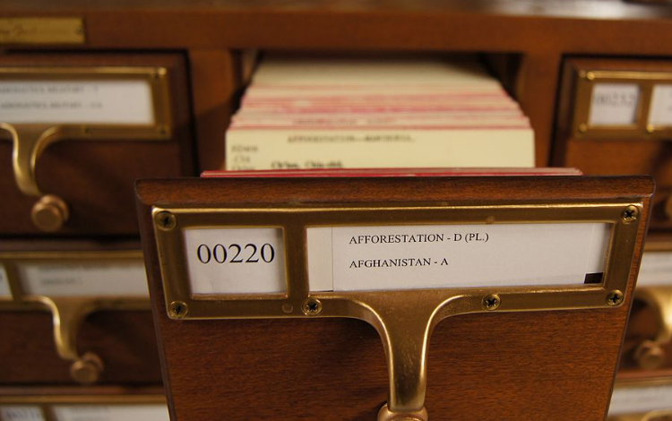

Data Carving
Read a book without an index card

Slide 2
Overview
How does a file system retrieve a file’s content? (review)
File content structure overview (review)
Exam file content using xxd
What is data carving?
Scenario 1: carving embedded files
Extracting images from a corrupted Word document using bless
Scenario 2: carving deleted files
Carving a USB image using scalpel

Slide 3
How does a file system retrieve a file’s content?

Slide 4
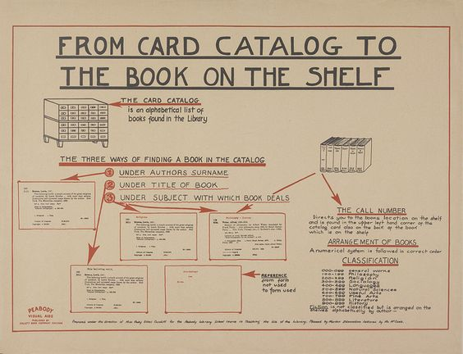

Slide 5
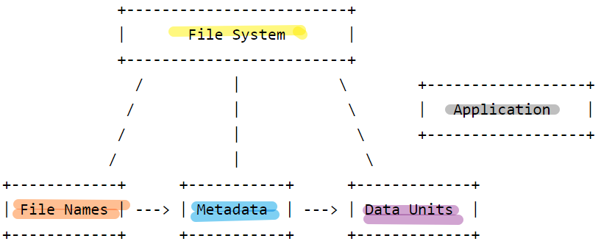
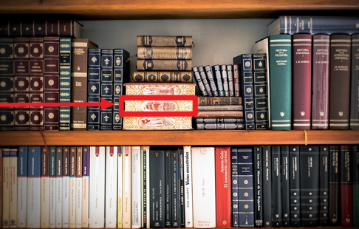

Slide 6
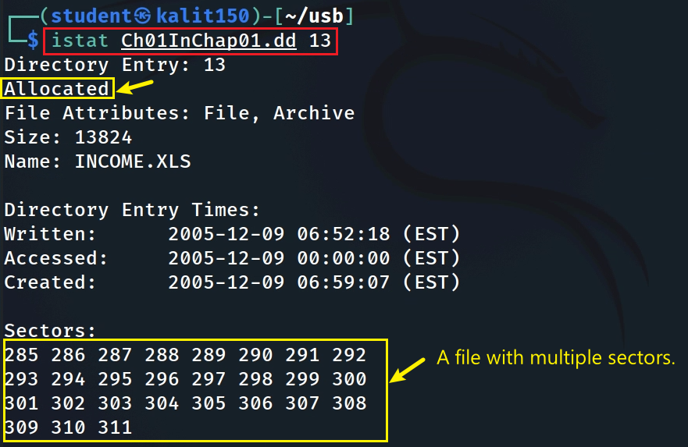
Scenario 1: Directly access data units (sectors) of a file in a dd image (FAT)
https://www.dropbox.com/s/nw23q14vzsykyup/Ch01InChap01.dd
27 sector & 512 bytes
Notes:
https://www.dropbox.com/s/nw23q14vzsykyup/Ch01InChap01.dd

Slide 7
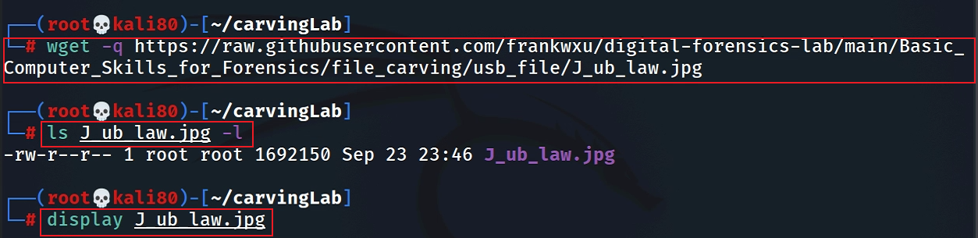
Scenario 2: Directly access data units (blocks) of a file in Linux (Ext4)
Download an image to Kali
sudo apt install imagemagick
if display doesn’t work
Notes:
wget -q https://raw.githubusercontent.com/frankwxu/digital-forensics-lab/main/Basic_Computer_Skills_for_Forensics/file_carving/usb_file/J_ub_law.jpg

Slide 8
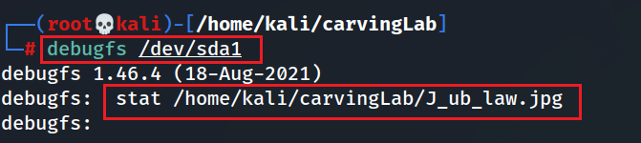
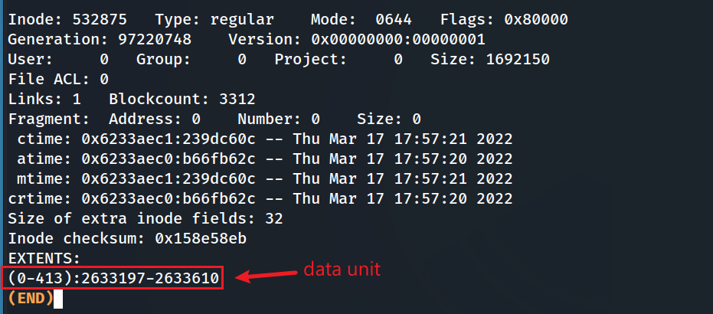
Show data units (blocks) of the image using debugfs
real size (1 block is 4k)
Notes:
sudo tune2fs -l /dev/sda1 | grep Block

Slide 9
File content structure overview

Slide 10
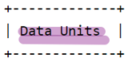


File Content overview
File signature
File content Metadata
referred to as a magic number,
a constant numerical/text value
used to identify a file format
content
reference to
istat: Displays the statistics and details about a given meta data structure in an easy-to-read format.
Tail signature
Content

Slide 11
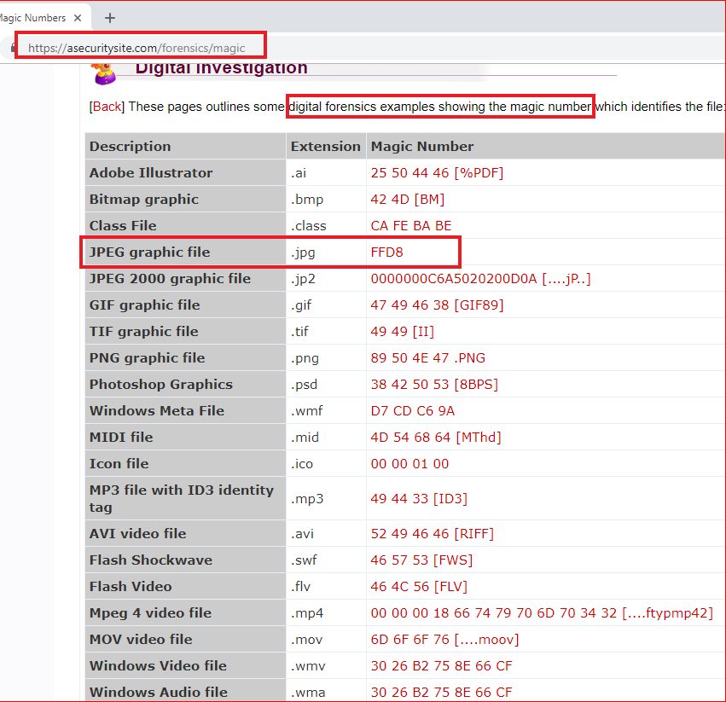
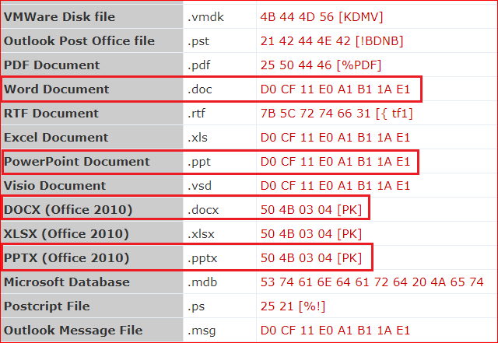

Slide 12
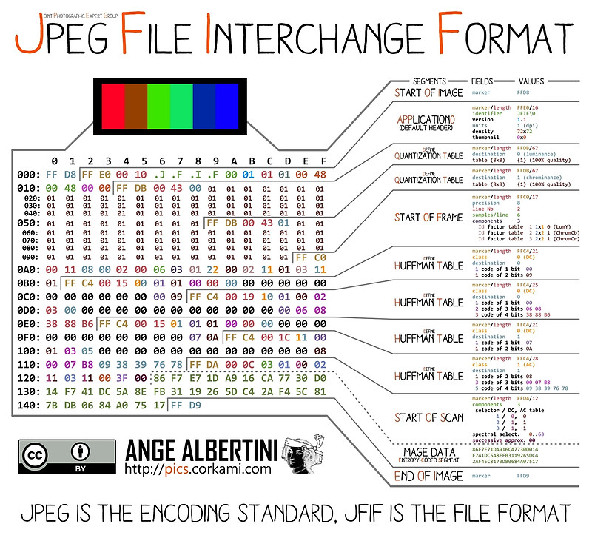
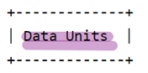
An example of image file content internal structure
points to
points to
Notes:
https://www.offshoreclippingpath.com/difference-between-jpg-and-jpeg/

Slide 13
Compressed content- Huffman Coding
JPEG Image Compression
Invented by David Huffman
a graduate student at MIT in 1952
as part of his course work.
Huffman coding can be used to compress all sorts of data.
It is an entropy-based algorithm that relies on an analysis of the frequency of symbols in an array.

Slide 14

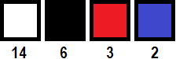
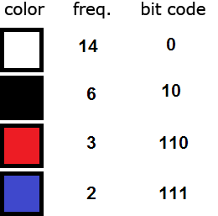
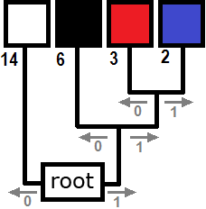
Each pixel requires 14 bits = 2³ (row)+2³ (col)+2⁸ (color)
(000)(100)(11111111)
Total: [6 (position) + 8 (color) ]*25=250
Before compression
sort the colors in order of decreasing frequency.
traverse from root to each color
colors farthest from the root are the least frequent.
Total bits required after compression:
25 x 6 (position)+
14 x 1 + 6 x 2 + 3 x 3 + 2 x 3 (color)
= 150+41 =191
Compression process
After Compression
Notes:
https://www.print-driver.com/stories/huffman-coding-jpeg

Slide 15
Examining File Content
using xxd

Slide 16

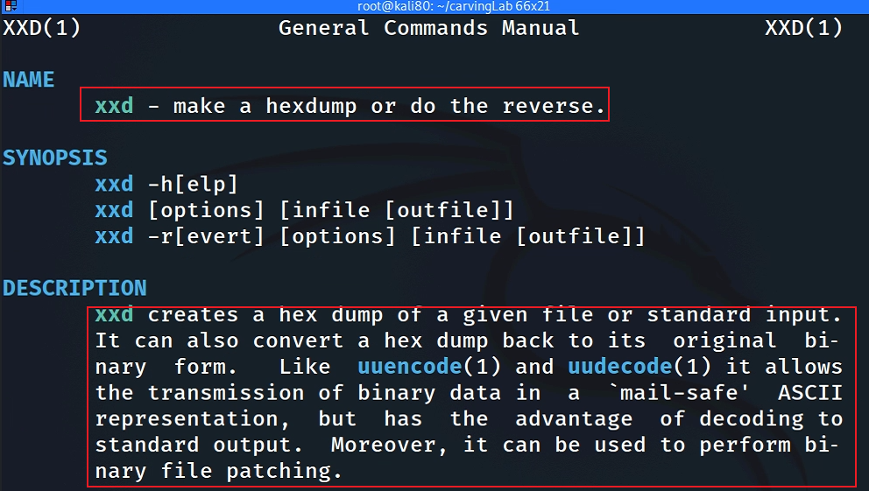
What is xxd? cli version of + binary file
disk
xxd
hex dump

Slide 17

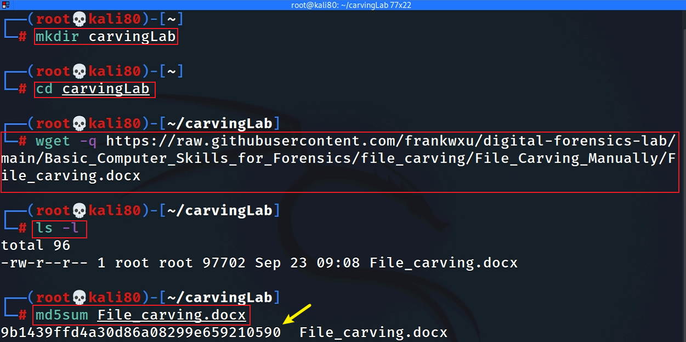
Get a jpg to show signature
sudo apt install imagemagick
if display doesn’t work
Notes:
wget -q https://raw.githubusercontent.com/frankwxu/digital-forensics-lab/main/Basic_Computer_Skills_for_Forensics/file_carving/usb_file/J_ub_law.jpg

Slide 18
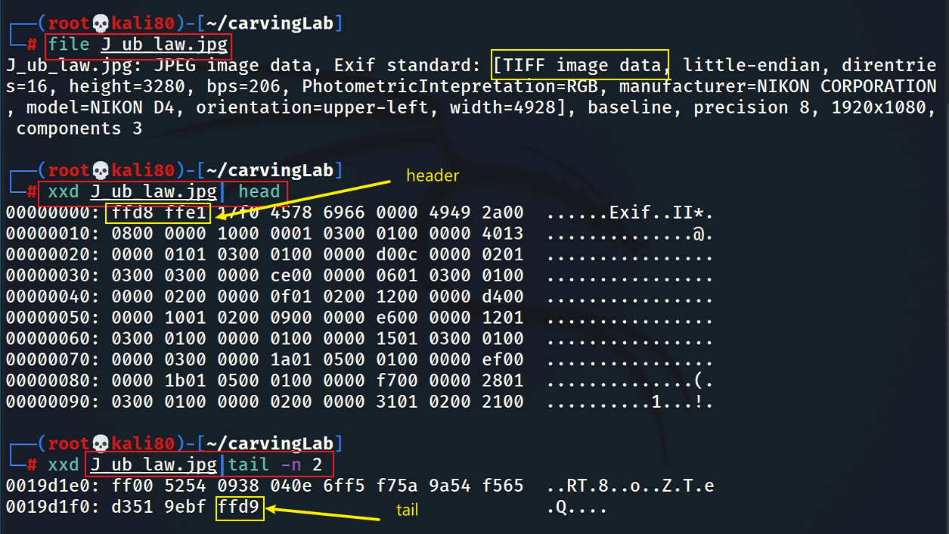
Show JPG header and tail signatures
The picture is taken by NIKON D4

Slide 19
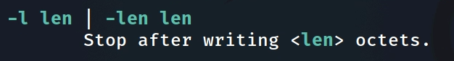
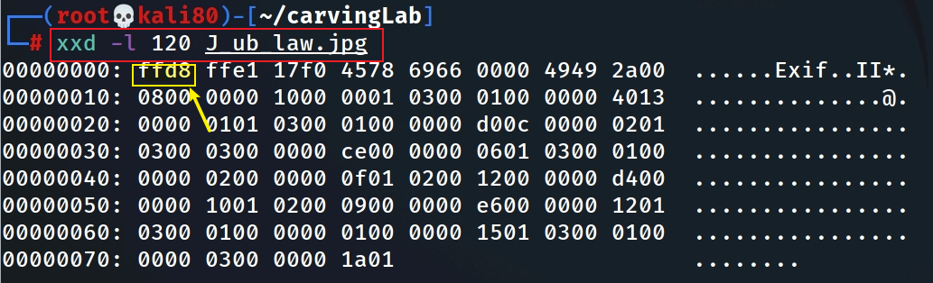
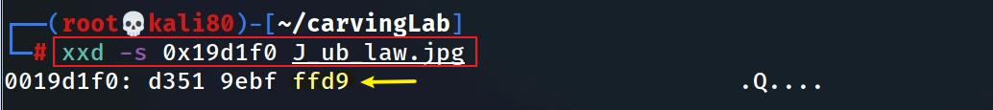
Alternative: Show JPG header and tail signatures
Alternative: Hexdump the first 120 bytes
Alternative: Show hex from a start address

Slide 20
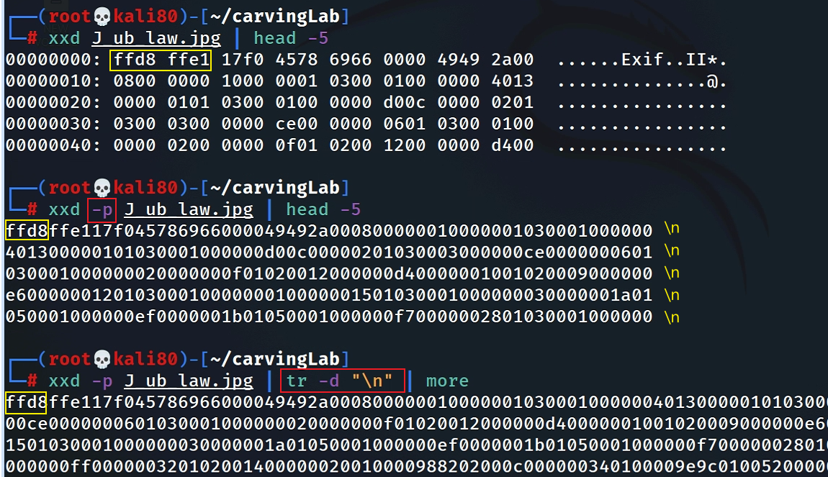
Search signatures in plain hexdump
Convert hexdump to plain hexdump
space causes search problem if we want to search for “ffd8ffe1” (show it in next slide)

Slide 21
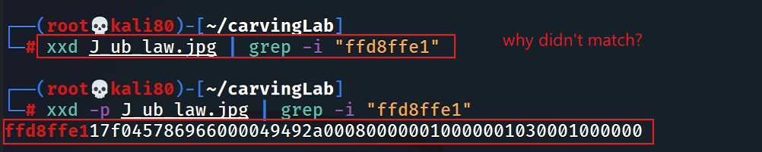
Search header in plain hexdump
Search tail in plain hexdump
How to search hex numbers between 2 lines? e.g., 0105?

Slide 22
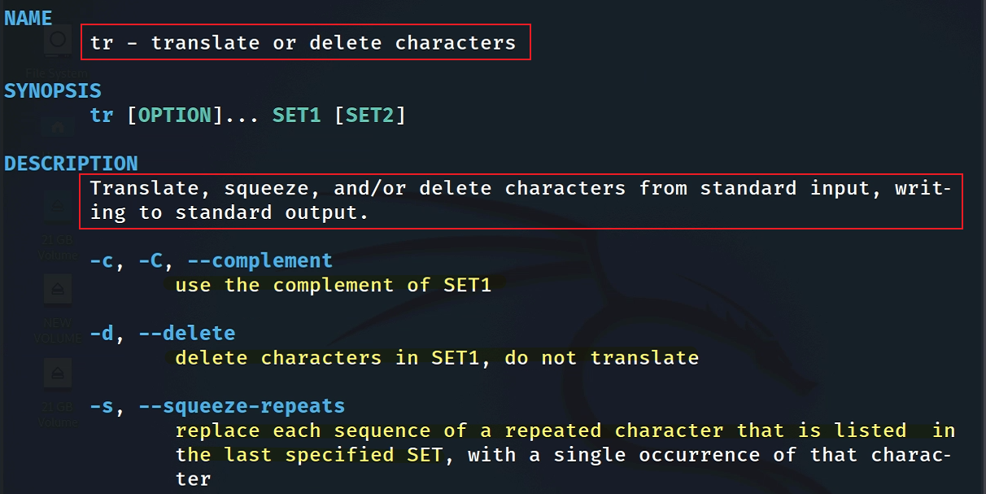
remove newline “\n”
tr command introduction

Slide 23
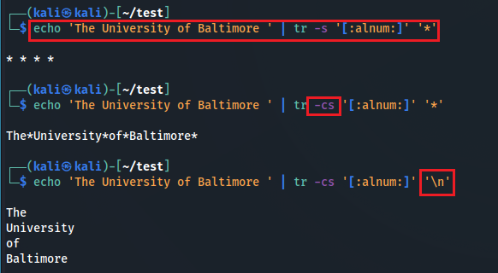
squeeze alphabets and numbers and replace them with *
squeeze NON (alphabets and numbers) and replace them with *
squeeze NON (alphabets and numbers) and replace them with \n
Notes:
echo 'The University of Baltimore ' | tr -s '[:alnum:]' '*’
echo 'The University of Baltimore ' | tr -cs '[:alnum:]' '*’
echo 'The University of Baltimore ' | tr -cs '[:alnum:]' '\n'

Slide 24
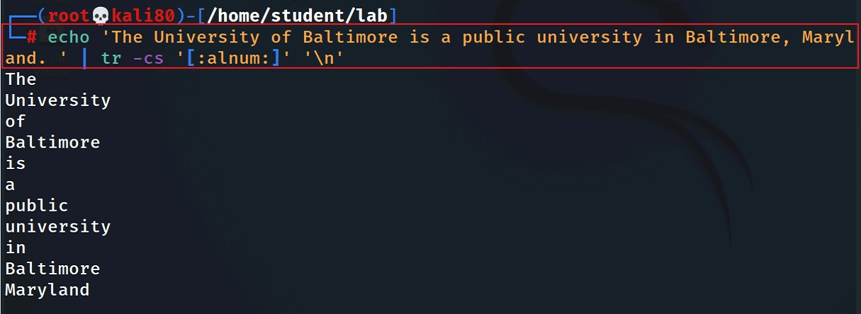
A small tr example: match all non-alphanumerical characters and replace them with a new line
Two tasks:
Squeeze repeated characters listed in a set ‘’
replace squeezed with “\n”
Notes:
echo 'The University of Baltimore is a public university in Baltimore, Maryland. ' | tr -cs '[:alnum:]' '\n'

Slide 25
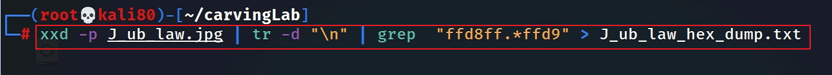
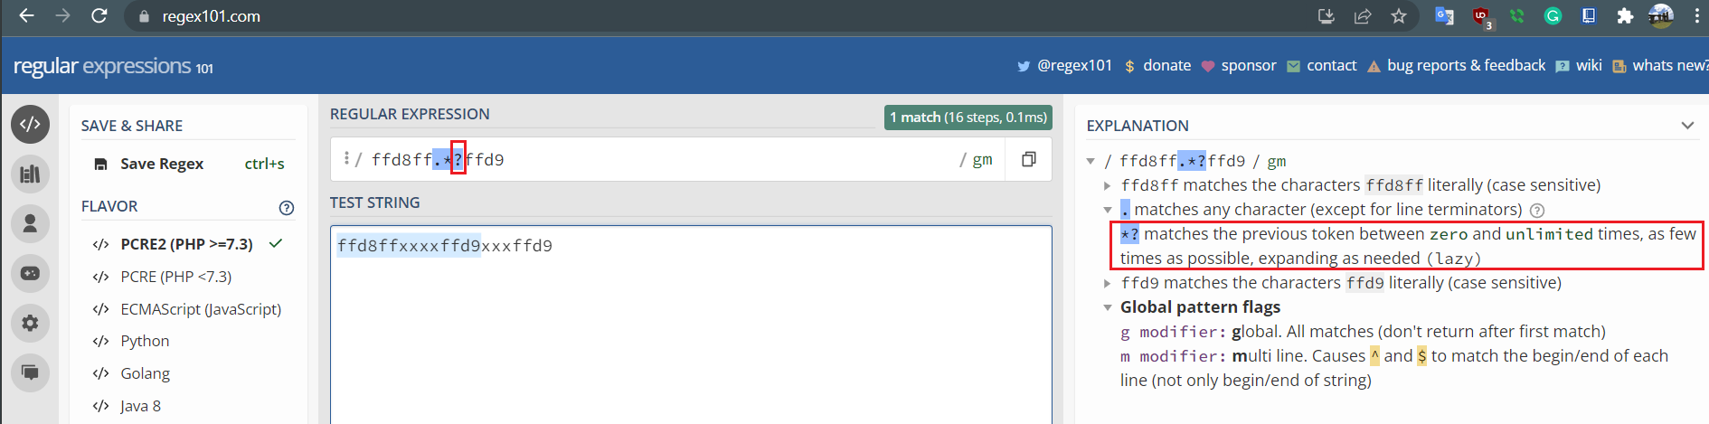
Dump the content between header and tailer signature
Match plain hexdump between header and tail signature and save the plain hexdump to a textfile
-o
Notes:
xxd -p J_ub_law.jpg | tr -d "\n" | grep - o "ffd8ff.*ffd9" > J_ub_law_hexdump.txt

Slide 26
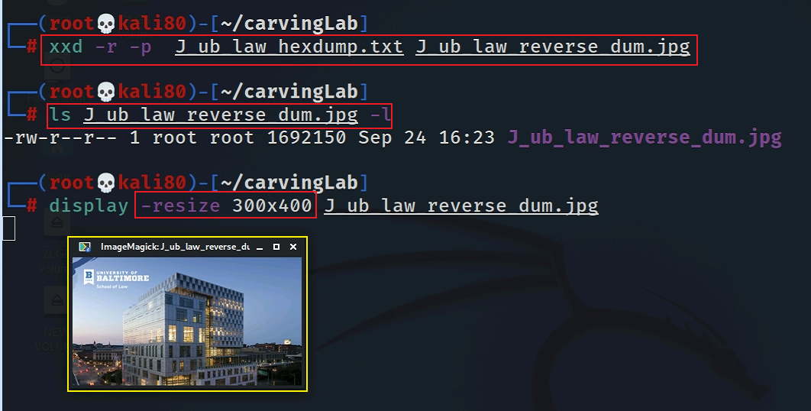
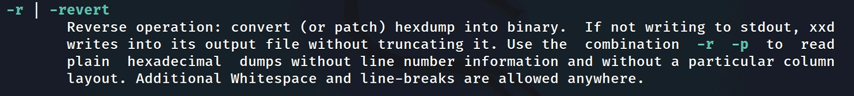
Convert a plain hexdump to back into binary
Notes:
xxd -r -p J_ub_law_hexdump.txt J_ub_law_reverse_dum.jpg

Slide 27

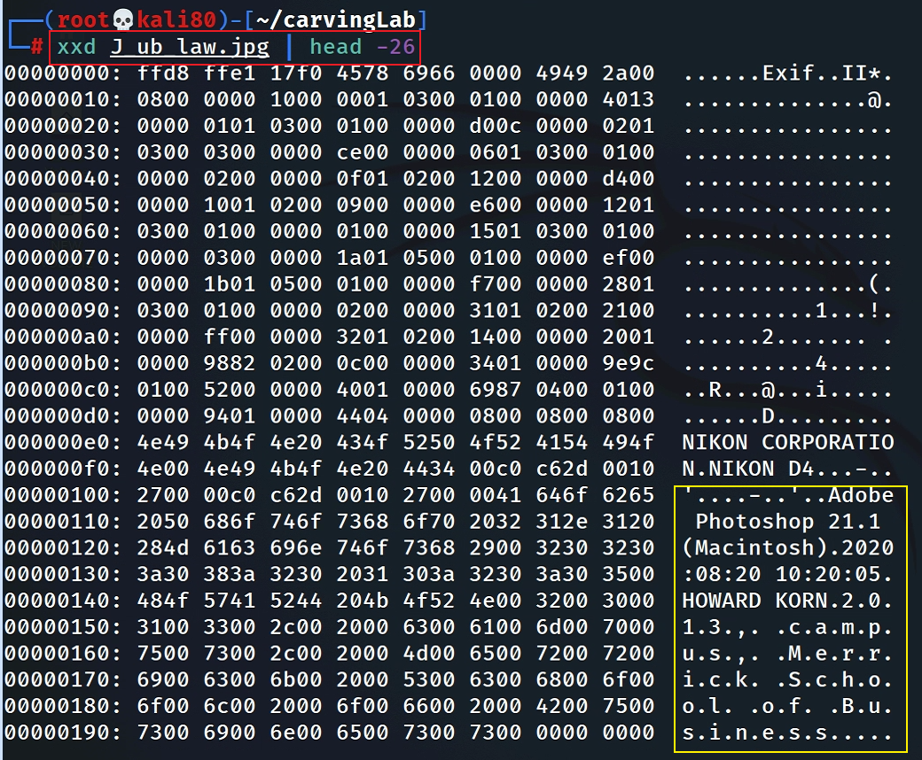
Interesting evidence in file header

Slide 28
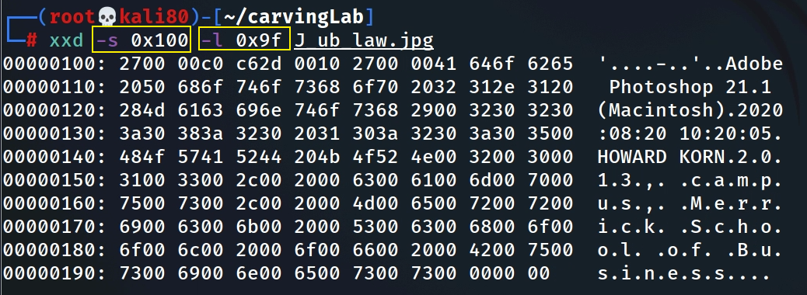
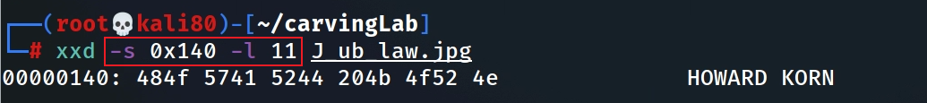
Hexdump Photoshop infor starts from 0x100 and list 0x9f bytes
Hexdump the name
Notes:
xxd -s 0x100 -l 0x9f J_ub_law.jpg

Slide 29
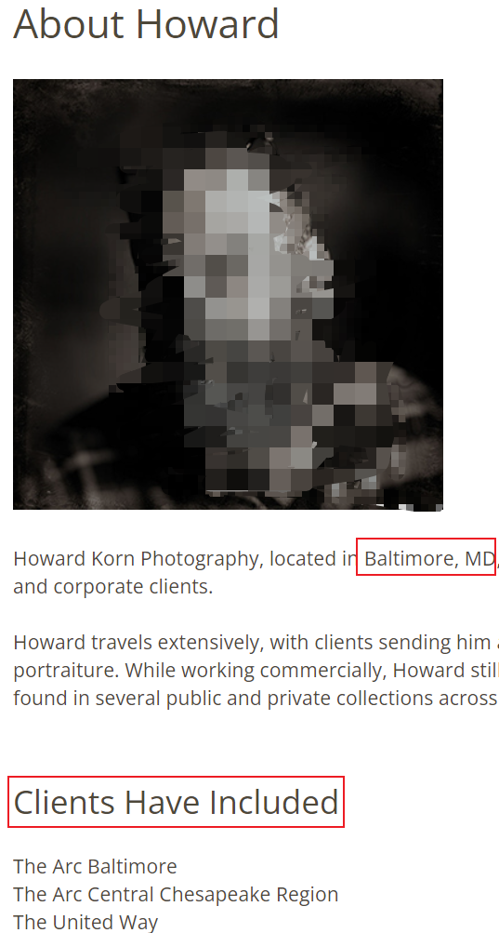
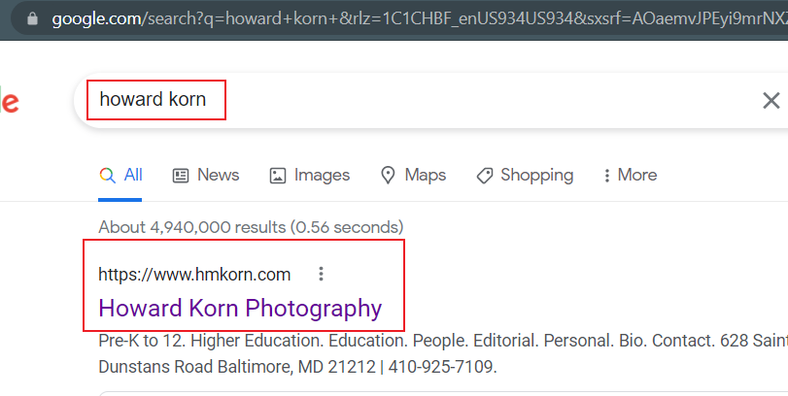
Who is Howard Korn?

Slide 30
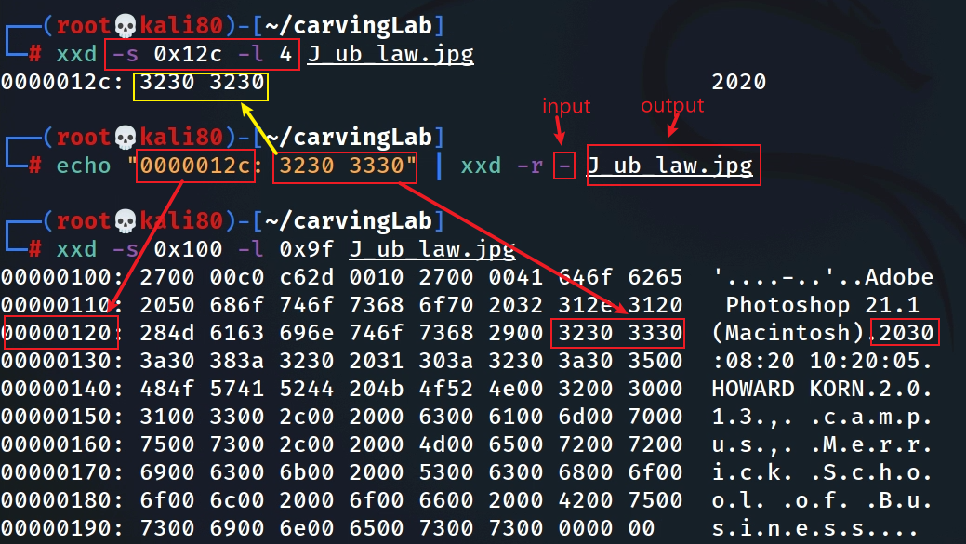
Fake the date (2020 -2030)
Hexdump the year
xxd reverses hexdump to binary (read from standard input. Overwrite 2020 with 2030)
If infile is specified as a `-' character, then input is taken from standard input.

Slide 31
Security implications
Modify software function
unlimited resource for games
Bypass security check
authentication
Insert malicious code
backdoor

Slide 32
What is data carving?

Slide 33







Anything can be wrong!
Corrupted MFT entry
unallocated clusters
corrupted file header
File1 | File2 | Deleted file

Slide 34
Data carving
Reassembling computer files from fragments in the absence of filesystem metadata
A well-known computer forensics term
aka file carving
Identify and extract (carve) the file
based on analysis of file formats (if a file head is corrupted)
based on file signature information
without the assistance of the file system that originality created the file

Slide 35
Example scenarios
Scenario 1: A file (A) is hidden inside of another file (B). You can’t open the file B because the B’s header is corrupted.
Scenario 2: A suspect deleted files. The files contains an important information. A file occupies a few clusters. Unfortunately, some clusters are reused (overwritten) by new files.
A forensic expert really wants to recover files, even a partial files.

Slide 36
Extracting images from a corrupted Word document
using bless

Slide 37
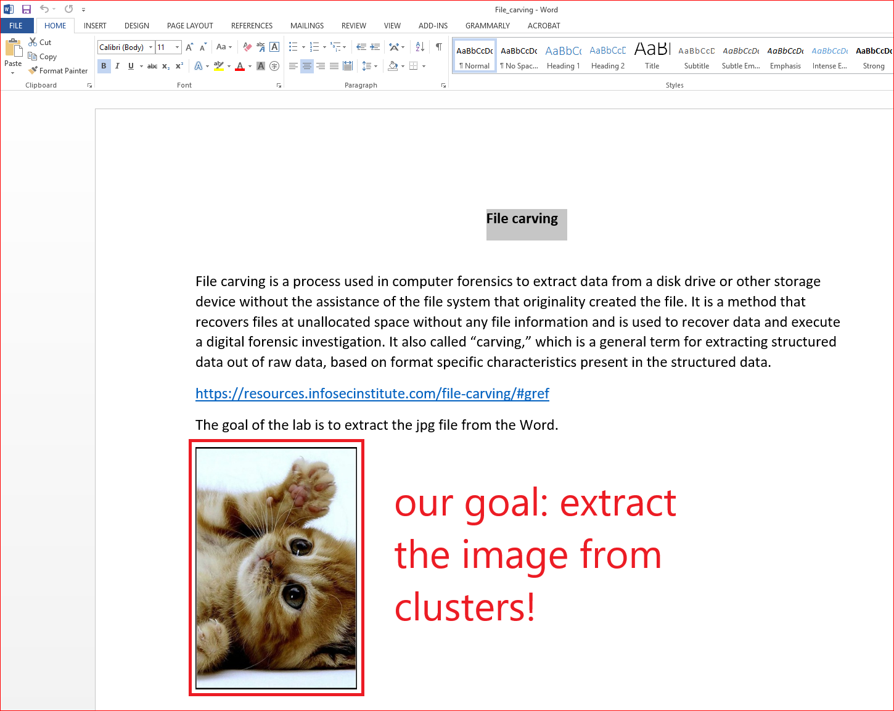
We can’t open the file because the file is corrupted (accidentally or intentionally)!
How to corrupted a file?

Slide 38
Prepare required files for the lab
the file we need
Notes:
wget -q https://raw.githubusercontent.com/frankwxu/digital-forensics-lab/main/Basic_Computer_Skills_for_Forensics/file_carving/File_Carving_Manually/File_carving.docx

Slide 39
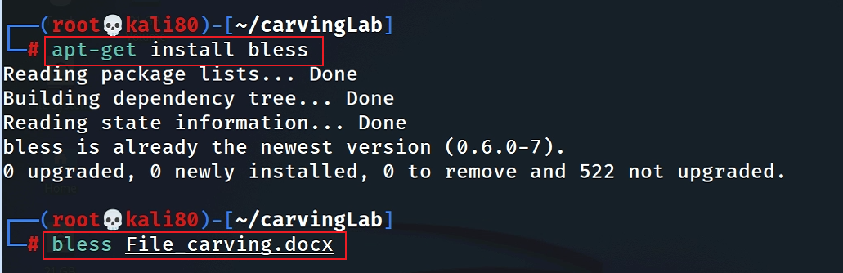
View the file in a hex editor
Notes:
ask for install

Slide 40
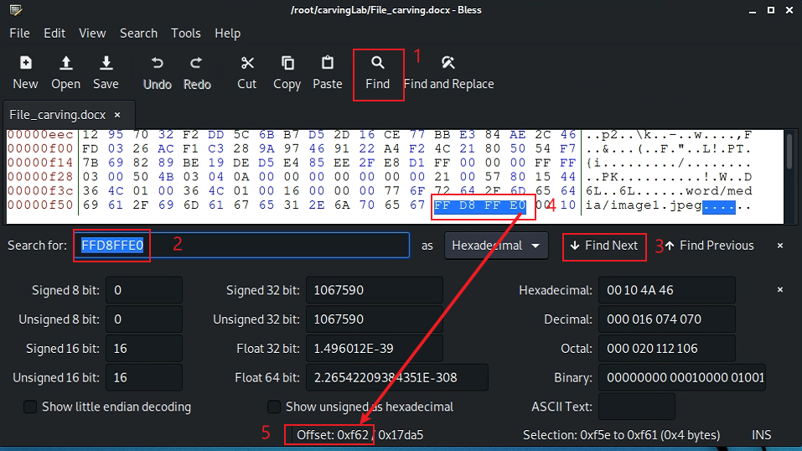
Search file header start offset – 0F5E
after the highlighted position

Slide 41
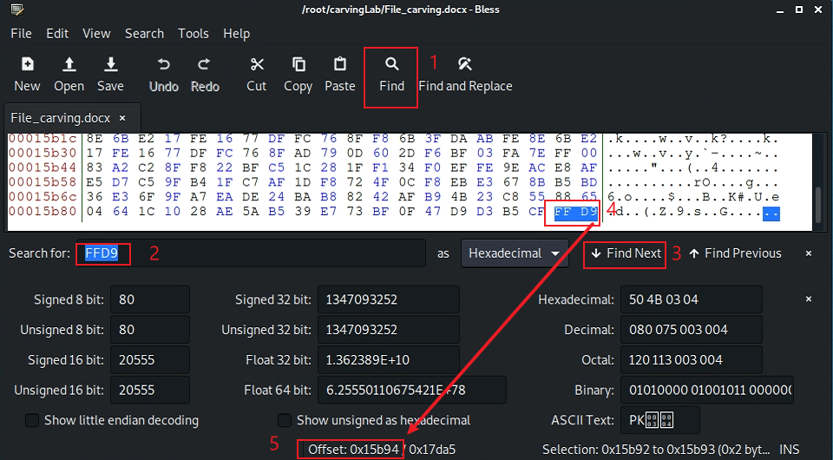
Search file trailer ends offset – 15B93
after the highlighted position

Slide 42
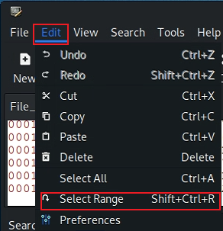
Select hex from header to tail
(0F5E)16=(3934)10
(15B93)16=(88979)10
Notes:
echo $((16#f5e))
echo $((16#15b93))

Slide 43
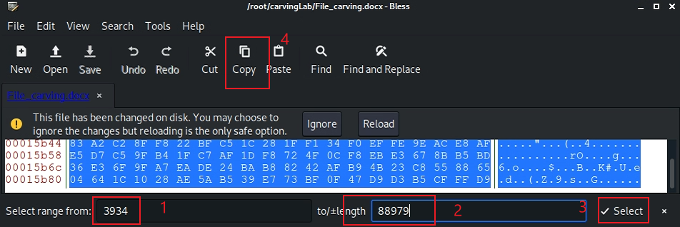

Copy the selection
0x0F5E
0x15B93

Slide 44
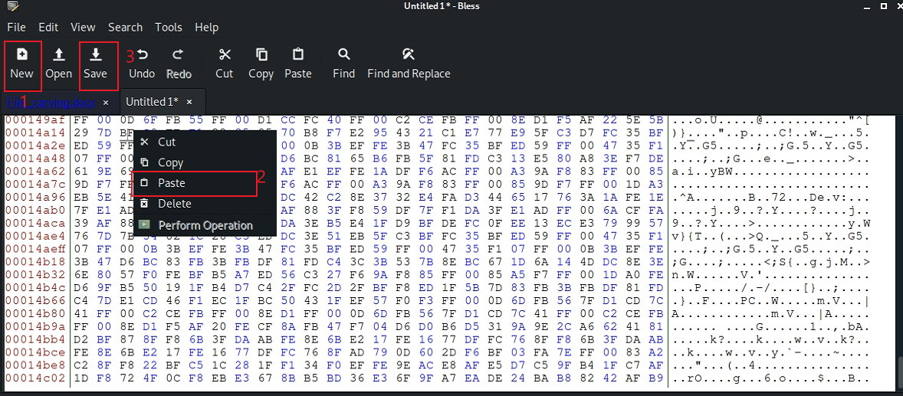
Paste the selection

Slide 45
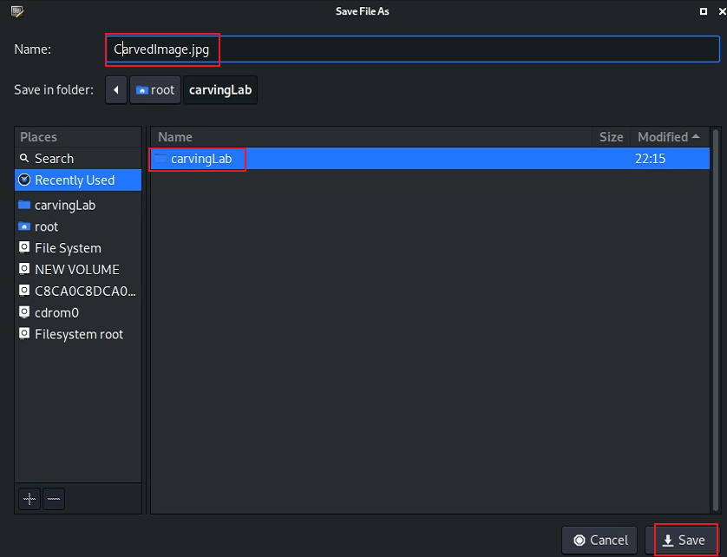
Save the image

Slide 46
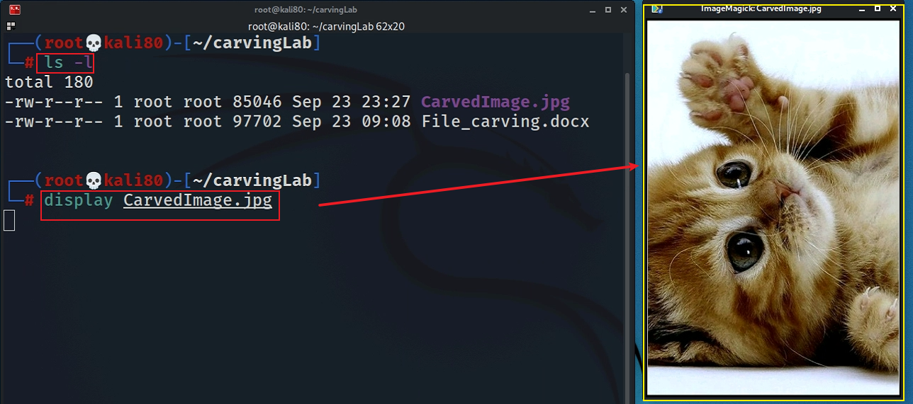
Show the carved image

Slide 47
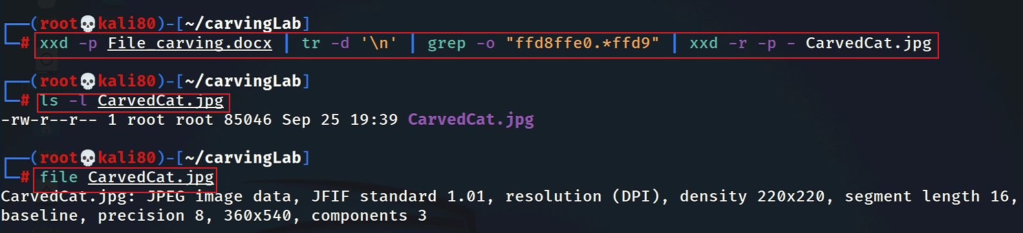
Alternative 1: using xxd
Must have –p, which tells xxd the input is a plain text
do you need a lazy match <.*?>
Notes:
xxd -p File_carving.docx | tr -d '\n' | grep -o "ffd8ffe0.*ffd9" | xxd -r -p - CarvedCat.jpg

Slide 48
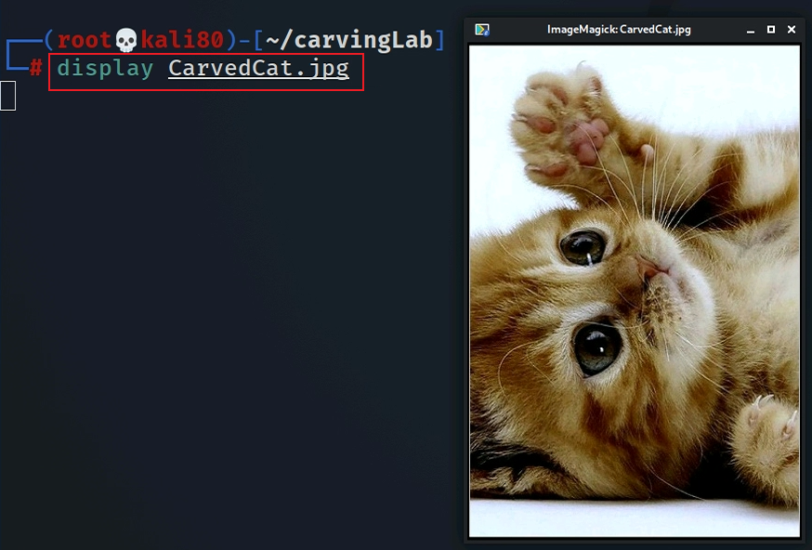

Slide 49
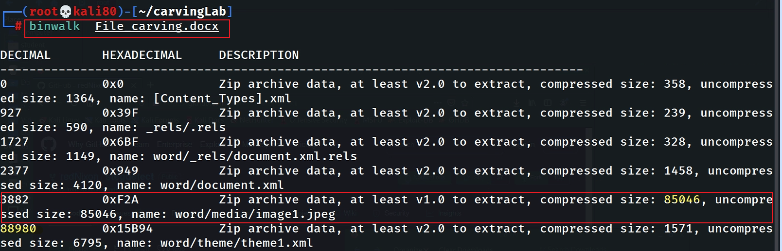
Alternative 2: using binwalk

Slide 50
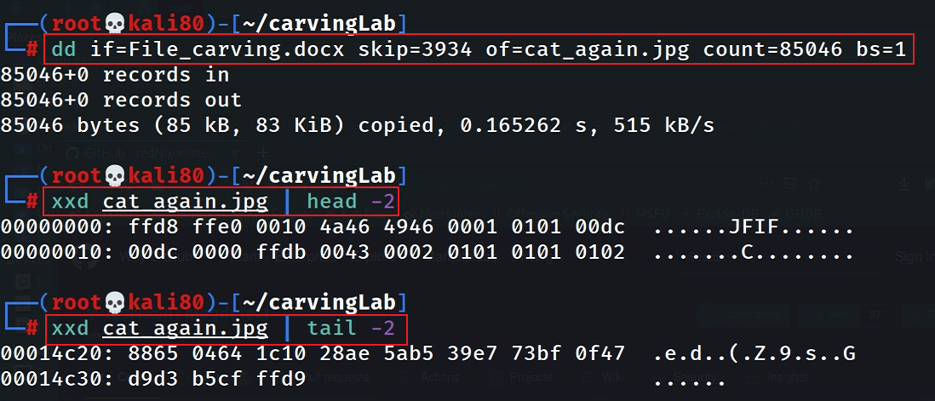
Why not start from 3882? Word doc includes an embedded header (52 bytes), i.e., 3934=3882+52
88980-85046=3934

Slide 51

Alternative 3: using binwalk -e

Slide 52
Carving/Recovering a USB image
using scalpel

Slide 53


Prepare a USB image for file carving
Download the zipped USB image
Compute hashes
Notes:
wget -q https://raw.githubusercontent.com/frankwxu/digital-forensics-lab/main/Basic_Computer_Skills_for_Forensics/file_carving/usb_image/120M.7z

Slide 54

List the content of the zipped file

Slide 55

List the content of the zipped file
e : Extract files from archive (without using directory names)

Slide 56

Verify the hashes

Slide 57

Exam the content of the USB
Display partitions

Slide 58

Find deleted files

Slide 59

Decide which file types need to carve
Save it and quit!

Slide 60

Show help

Slide 61

Carving the USB image

Slide 62

Show carved files

Slide 63

Show audit log

Slide 64


Display two carved jpg image

Slide 65
Summary
File header and tail signatures are used to identify file types
The content of a file is enclosed in header and tail signatures
Many tools can used for carving file content
Note the file names/metadata can’t be retrieved

